Slide 1
INTRODUCTION TO MACHINE LEARNING
Nguyen Minh Quan – 521H0473
Nguyen Dinh Viet Hoang – 522H0120

Slide 2
Machine Learning
Question 1
Present the steps in solving a classification problem or regression problem using machine learning methods
Perform the steps in question 1 on a classification or regression problem using different machine learning methods. Evaluate and compare the results of applying these methods
Find solutions to improve the accuracy of the models mentioned in question 2
Question 2
What is Overfitting phenomena ?
Present solutions to avoid overfitting
Present the problems mentioned in questions 1 and 2 through one or more real data sets
Summary

Slide 3
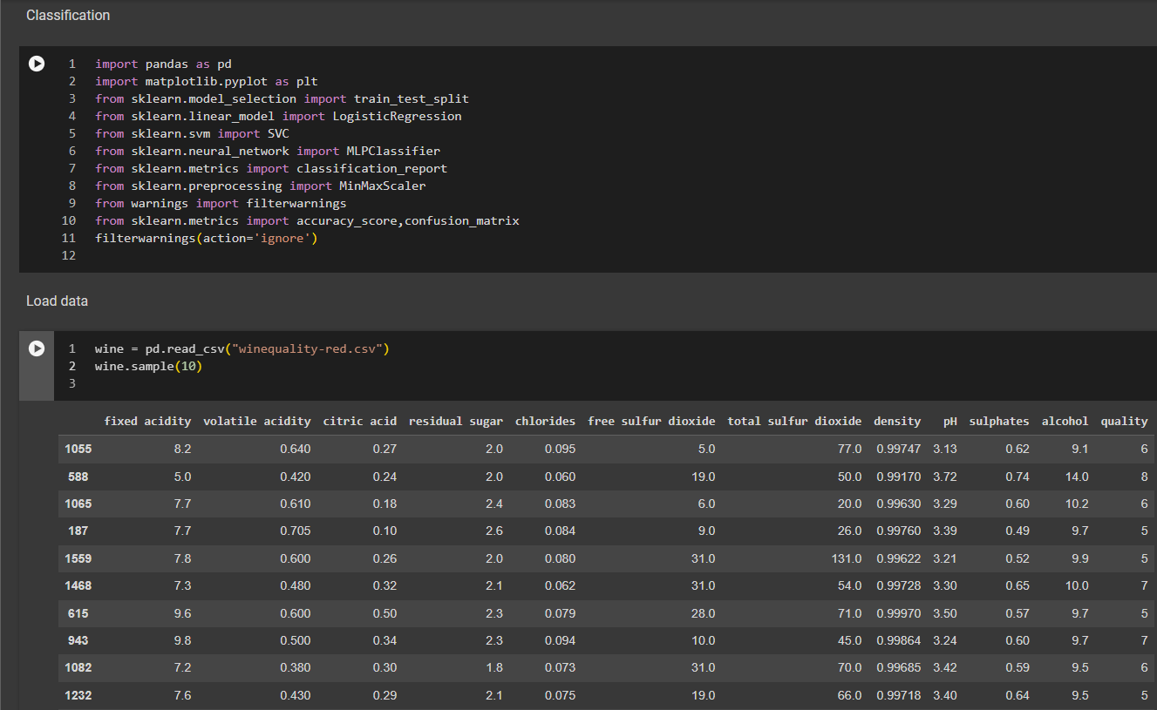
Present the steps and perform the steps on a classification problem
Step 1 : Data Gathering

Slide 4
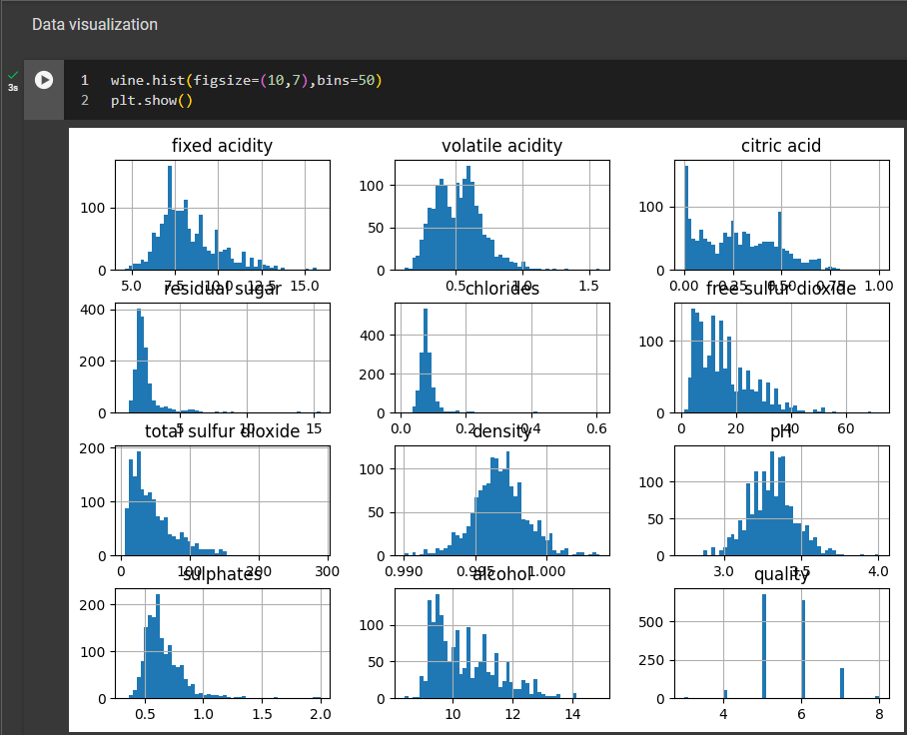
Present the steps and perform the steps on a classification problem
Step 2 : Data Preprocessing

Slide 5
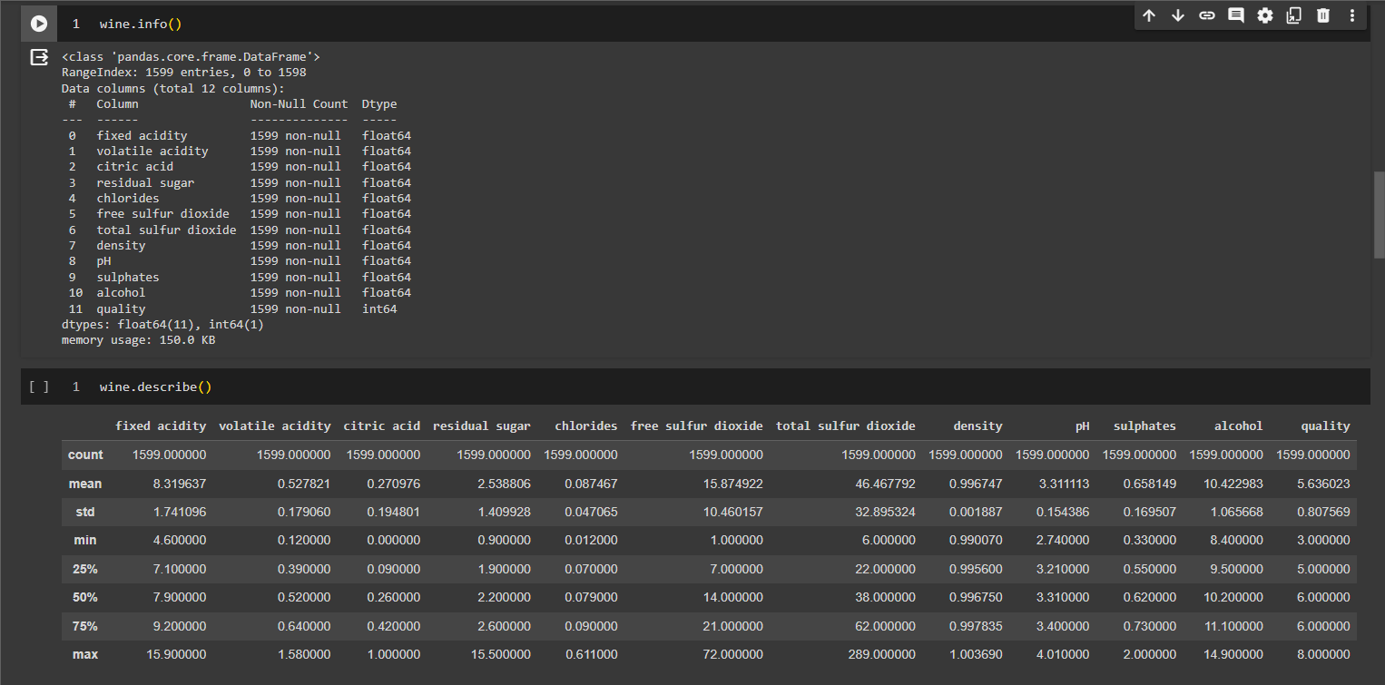
Present the steps and perform the steps on a classification problem
Step 2 : Data Preprocessing

Slide 6
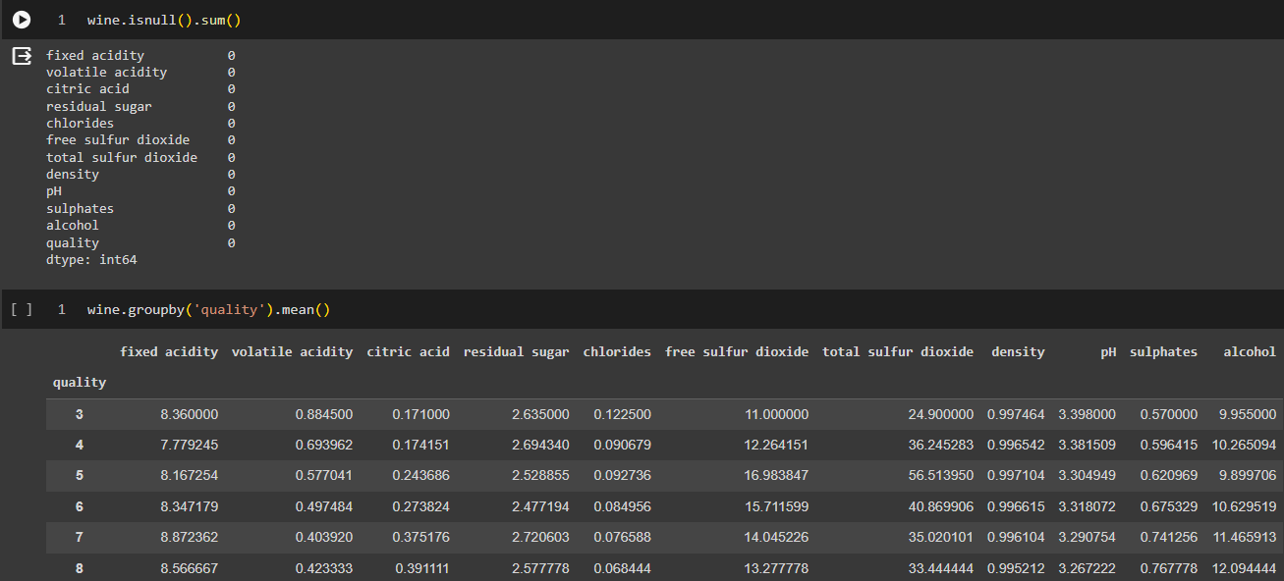
Present the steps and perform the steps on a classification problem
Step 2 : Data Preprocessing

Slide 7
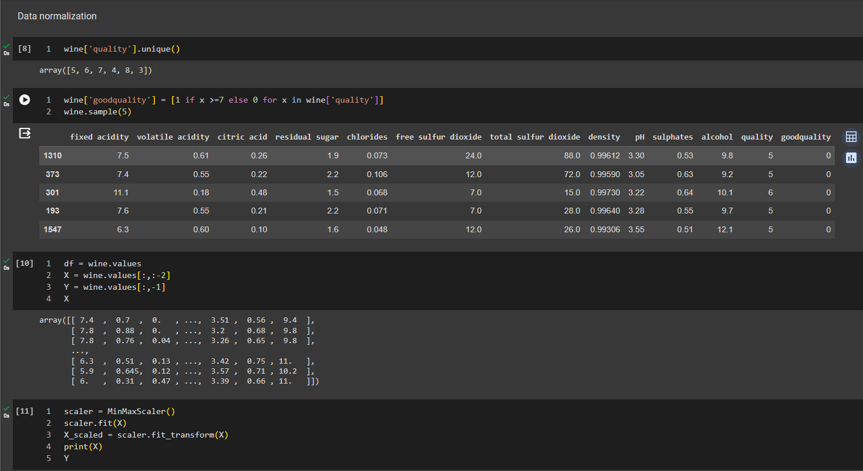
Present the steps and perform the steps on a classification problem
Step 2 : Data Preprocessing

Slide 8
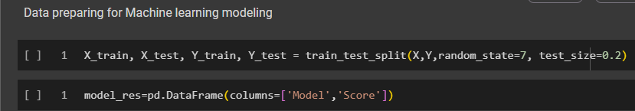
Present the steps and perform the steps on a classification problem
Step 2 : Data Preprocessing

Slide 9
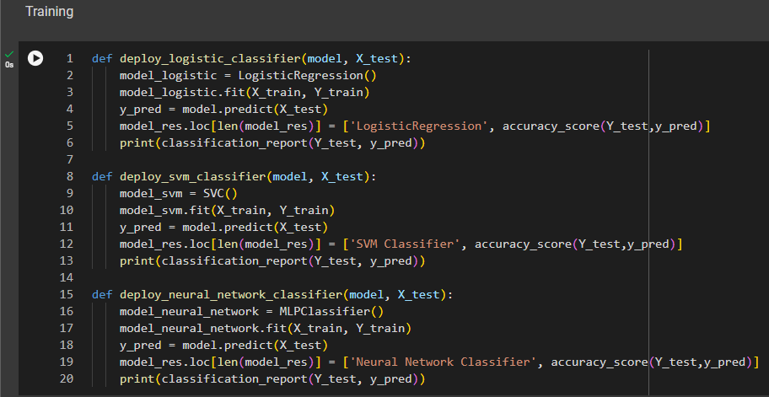
Present the steps and perform the steps on a classification problem
Step 3 : Model Selection

Slide 10
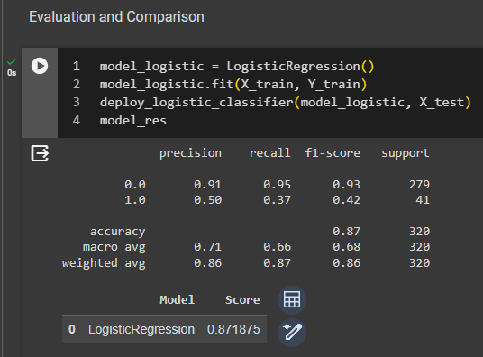
Present the steps and perform the steps on a classification problem
Step 4 : Evaluation and Comparison
This is the result of LogisticRegression model

Slide 11
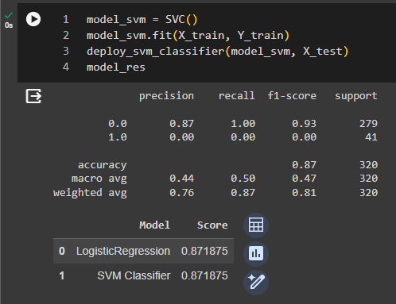
Present the steps and perform the steps on a classification problem
Step 4 : Evaluation and Comparison
This is the result of SVC Classifier model

Slide 12
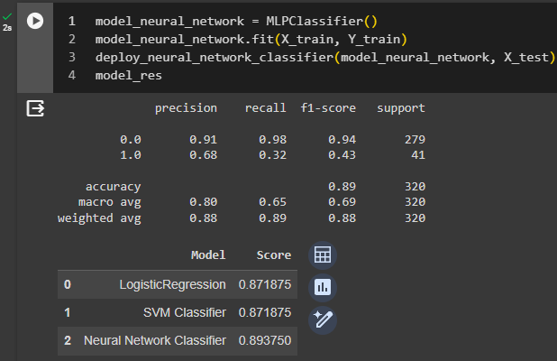
Present the steps and perform the steps on a classification problem
Step 4 : Evaluation and Comparison
This is the result of Neural Network Classifier model

Slide 13
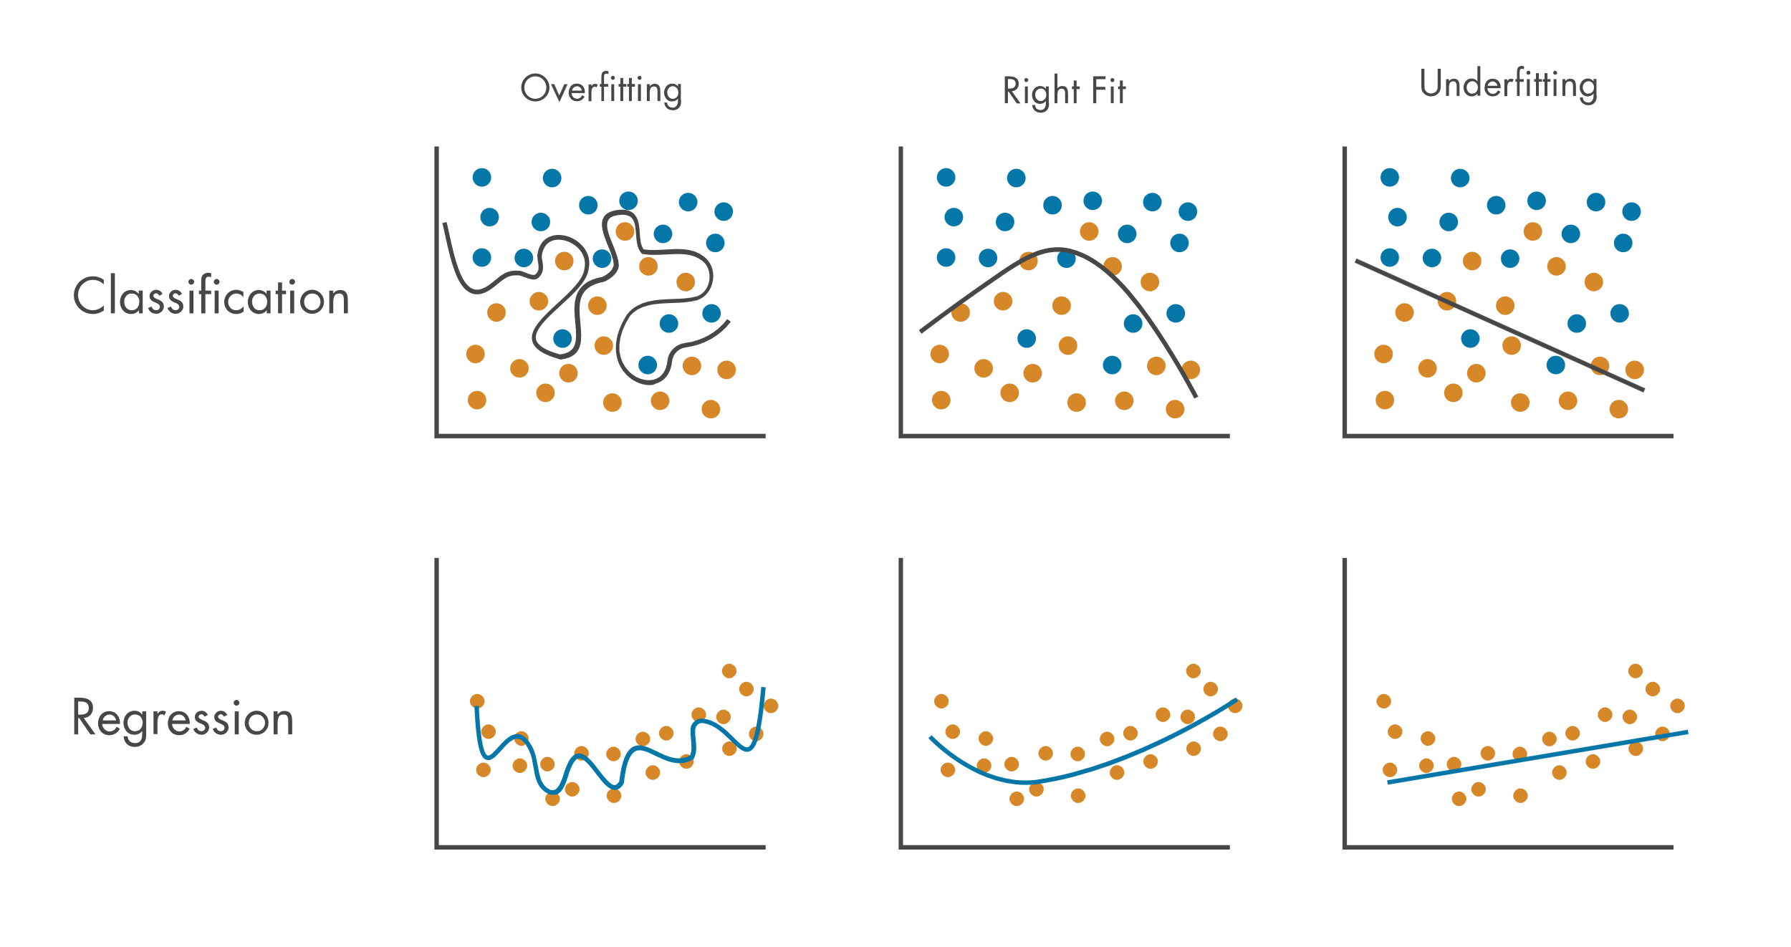
What is Overfitting ?
Overfitting is a common problem in machine learning where a model learns the training data too well, to the extent that it memorizes noise or random fluctuations rather than learning the underlying pattern of the data. This can lead to poor performance when the model is used on new, unseen data.

Slide 14
Causes of Overfitting
Excessive features: An abundance of features relative to observations can cause the model to tightly fit to the training data's specific details.
Model complexity: A highly intricate model with numerous parameters is more prone to overfitting.
Inadequate training data: A limited dataset amplifies the risk of overfitting as the model may not encounter enough data variance to accurately learn underlying patterns.

Slide 15
Present solution to avoid overfitting
Solutions to avoid overfitting:
Cross-Validation: Split your data into multiple subsets for training and testing to evaluate the model's performance on different data.
Regularization: Add penalties to the model's complexity to discourage overly complex models that are prone to overfitting.
Feature Selection: Choose only the most relevant features to train the model, reducing the chances of fitting noise.
Early Stopping: Stop training the model when performance on a validation dataset starts to degrade, preventing it from memorizing the training data.
Ensemble Methods: Combine multiple models to make predictions, reducing the risk of overfitting by leveraging the wisdom of crowds.
Data Augmentation: Increase the size of the training dataset by generating new data points from the existing ones, helping the model to learn more generalized patterns.
Pruning: Trim unnecessary parts of the model such as unnecessary branches in decision trees or unused neurons in neural networks, reducing complexity and preventing overfitting.

Slide 16
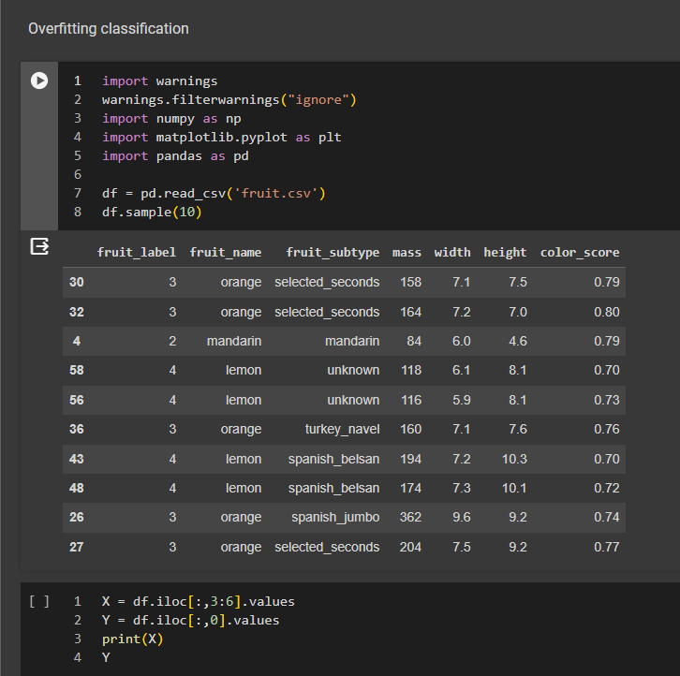
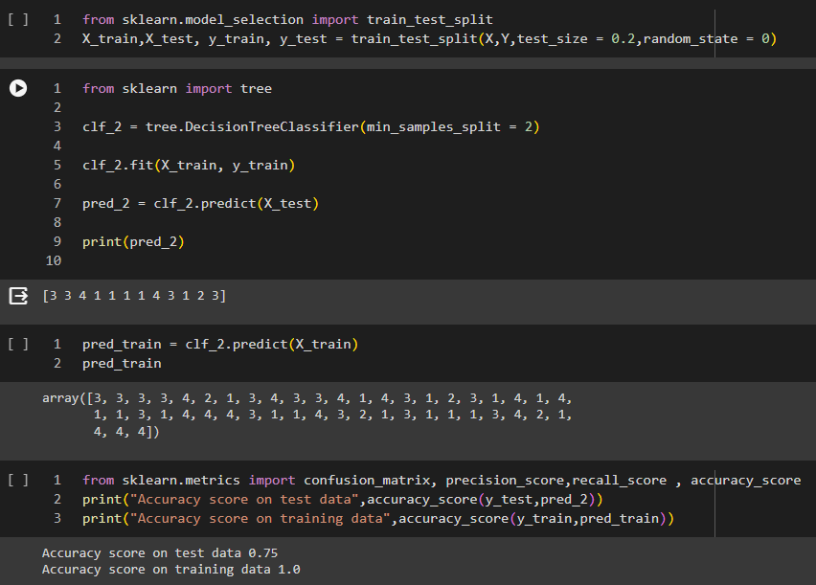
Example of Overfitting

Slide 17
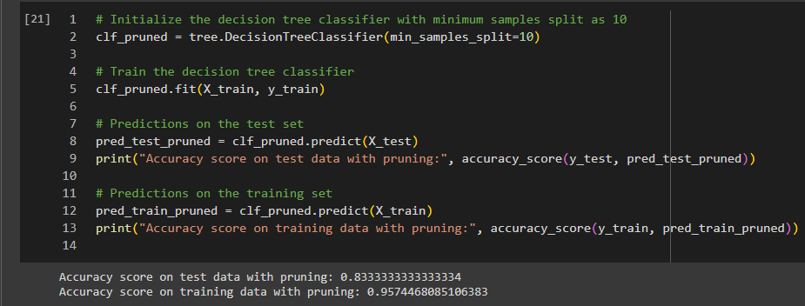
Solving Overfitting Classification

Slide 18
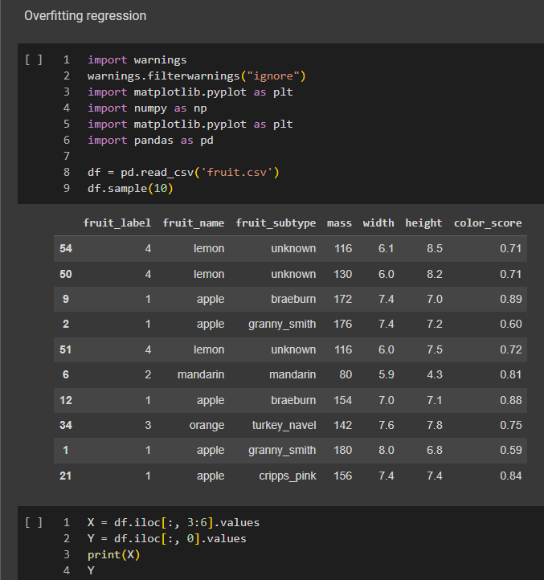
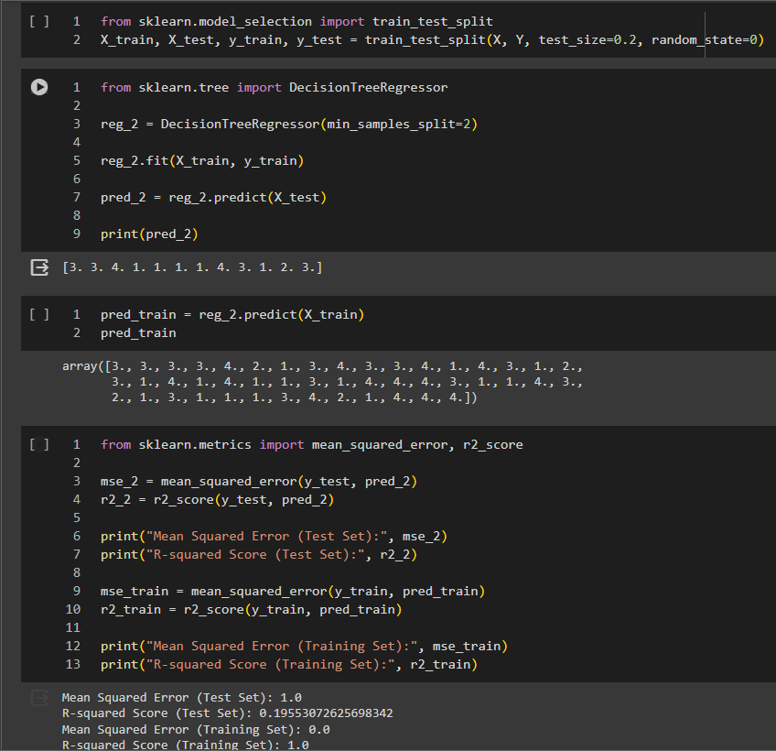
Example of Overfitting

Slide 19
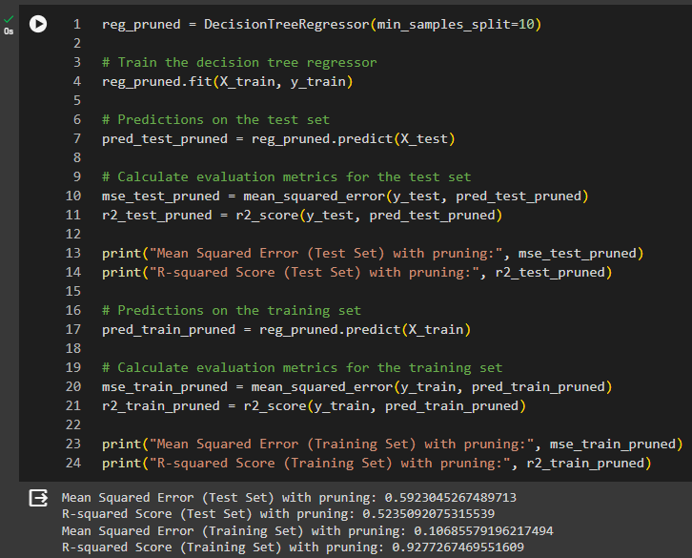
Solving Overfitting Regression

Slide 20
Thanks!
Any questions?

